Slide 1

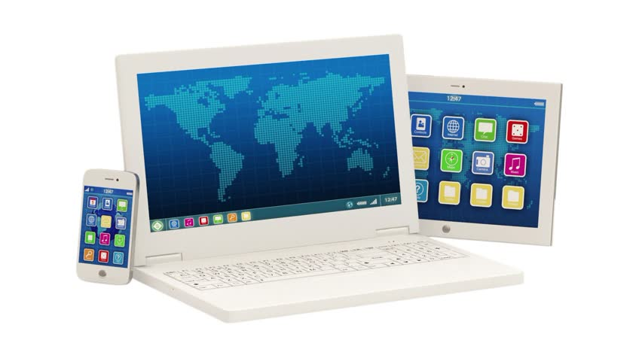
REMOTE MONITORING OF LAB USING SMARTPHONE APPLICATION
D.K.T.E. Society’s Textile and Engineering Institute, Ichalkaranji.
Department of Information Technology
2020-2021

Slide 2
Introduction :
a. Problem definition
To provide user friendly remote monitoring lab using smart phone application.
b. Need of the project with motivating example
If we want to know the status of all machines present in lab , instead of
checking individually we can check the system with help of this application.
This application can help in schools and colleges to check status of computers.

Slide 3
c. Objectives of project
Main purpose of this application is to save time for checking status of computer.
This app provides user friendly remote monitoring of lab.
To know about system configuration as per requirement.
d. Scope & limitations of project
Scope:
This application is help for recruitment process.
Limitations :
Internet connection required to access this application.
Only admin has rights to edit the status.

Slide 4
Timeline Of Project:
Group Created
Literature Survey
Discussion With Industrial Guide
Topic Discussion
Project Review
Project Study

Slide 5
Literature:
Technology review:
firebase:
Firebase is a platform developed by Google for creating mobile and web applications. For storing lab machines information to database on cloud we have used this.
dart:
Dart was released by Google in 2011. Is a client-optimized programming language. Object-oriented with C-style syntax. Fast on all platform.

Slide 6
Flutter:
Flutter is Google’s UI toolkit for building mobile, web, desktop, and embedded devices from a single codebase
HTTP:
Is a protocol which allows the fetching of resources, such as HTML documents. It is the foundation of any data exchange on the Web and it is a client-server protocol.
HTML:
To display the information of os and computers configuration.

Slide 7
Requirement Analyasis:
Operating System Requirement:
windows, android
Hardware requirement:
Processor: Intel ® Core™2 Due CPU E7500 @ 2.93GHz 2.93 GHz
Ram: 4/8 GB
Keyboard: optical
Monitor: 15 inch color
Mouse: optical
Tools and Technologies Requirements:
visual studio, android studio, firebase, dart, mysql,git.

Slide 8
Modules:
Module1: Login/sign up page
Input: email and password
Output: successfully form entry
Description: It will take only valid email and password
Module2:Dashboard
Input : none
Output: It will display list of labs.
Description: click on lab you want.

Slide 9
Module 3: computer arrangement
Input: none
Output: It will display arrangement of computers
Description: click on computer you want to check
Module 4: Status of computer
Input: none
Output: It will display system configuration
Description : We can get actual information of status here.

Slide 10
Module 5: complaint box
Input : student add complaint
Output: complain send

Slide 11
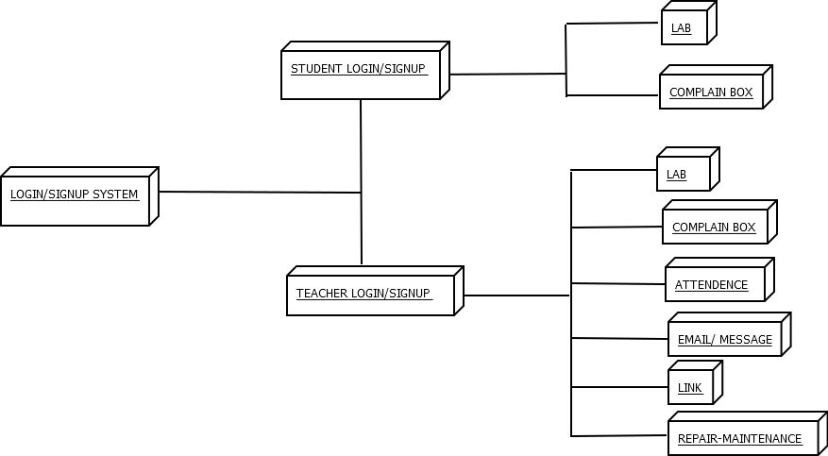
System Design: Architectural Design:

Slide 12
References:
International Research Journal of Engineering and Technology (IRJET) www.irjet.net
IEEE Transaction paper on Addressing the Bandwidth Efficiency, Control,
and Evaluation Issues in Software Remote Laboratory.

Slide 13
THANK
YOU !!!

